Slide 1
Object Orientated Programming
Group Members:
Talha Javed
Saad Obaid ul Islam

Slide 2
Orientation Assistance Application

Slide 3
Introduction
Orientation Assistant is an interactive application for Students and Faculty Members of NUST.
Freshmen can use this app to find others with matching interests, to get information about NUST and to simply find stuff to do around NUST
Sophomores and Faculty can create events and invite appropriate freshmen to the events.

Slide 4
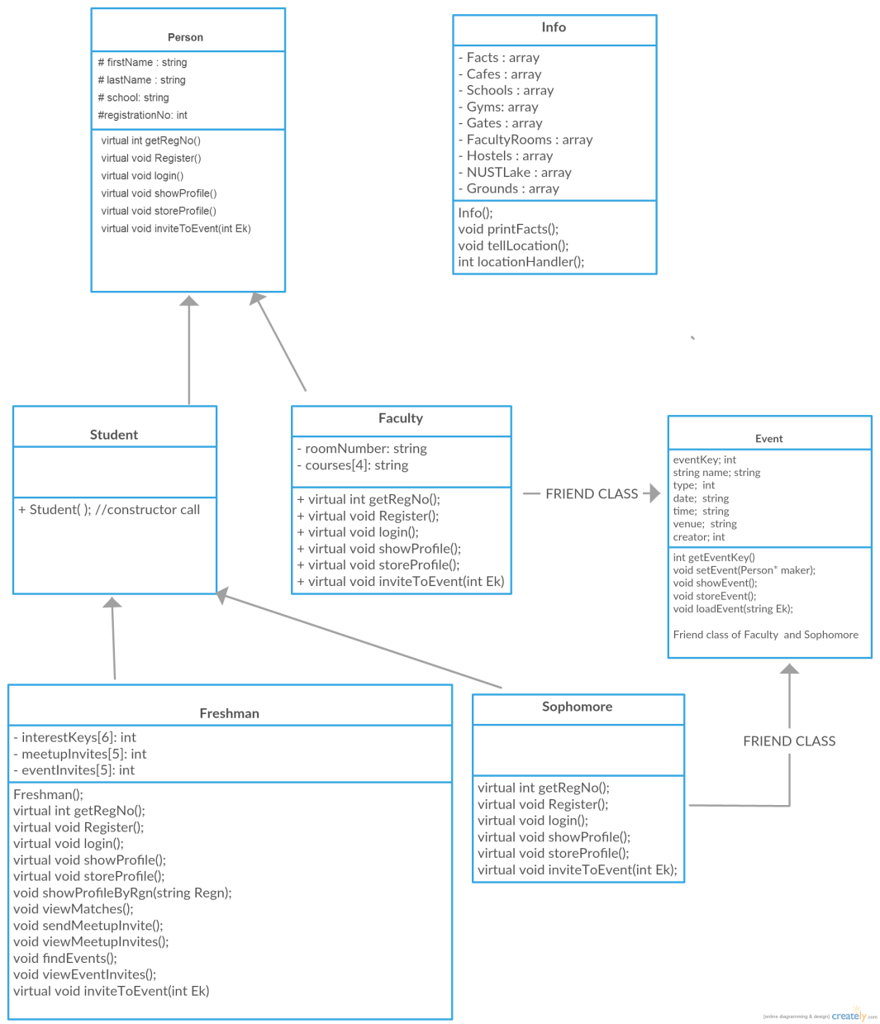
Class Diagram

Slide 5
Attributes and behavior of classes

Slide 6
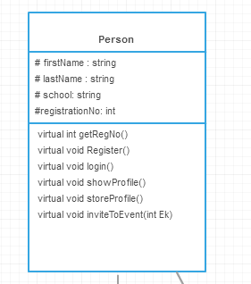
Person Class
Person class attributes are the first and the last name, the school in which he/she studies/ teaches and the registration number.
This is an abstract class. All functions are virtual.

Slide 7
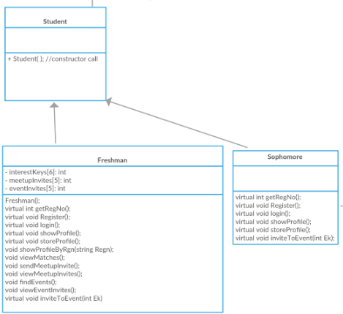
Student Class

Slide 8
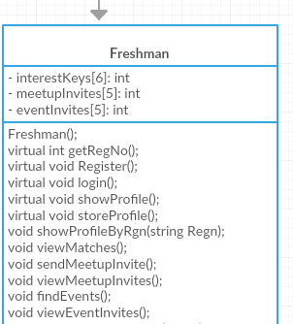
Freshman Class
Freshman has attributes of interests, the meet up invites and the event invites they have received.
Freshman can register and login, send a meet up invitation to other freshmen and see with whom his/her interests match the most.

Slide 9
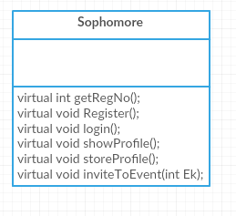
Sophomore Class
Attributes of Sophomore class is same as Person class.
A sophomore can register, login and send an invitation of an event to the freshmen

Slide 10
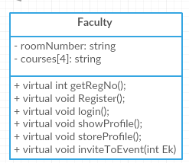
Faculty Class
A Faculty has attributes of their room number and the courses which they teach.
Faculty can register, login and send an event invitation to the freshmen.

Slide 11
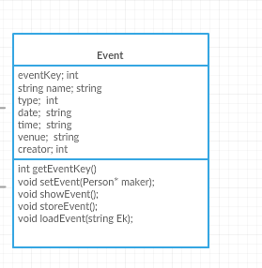
Event Class
The attributes this class has is an event key of an event, the name of an event, the type of an event, date, time and venue of an event, and the registration number of the creator of the event.
Event class can create an event and load the events.

Slide 12
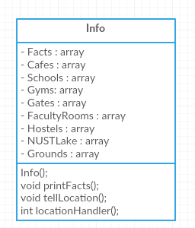
Info Class
Info class has attributes of some random fun facts about NUST university and the names of the buildings in NUST.
The class’ behavior is to print fun facts about NUST university and find a location in NUST.

Slide 13
Important Functions

Slide 14
Register Function: void Register()
This function is present in Freshman, Sophomore and Faculty class
Register Function is asking the user about their first name, last name, school, and registration number.
In Faculty class the program asks about the users faculty’s room number and the courses they teach.
In Student Class, registration function is also asking the user to rate the following things from 1 to 9 he/she finds interesting :
Sports
Books
Visual Arts
Music
Science
Food

Slide 15
Login Function: void login()
This function is present in Freshman, Sophomore and Faculty class.
User can enter his/her registration number to login.

Slide 16
Get Profile by Registration No. : className* getProfileByRgn()
This function is present in Freshman, Faculty and Sophomore class.
The program will first read the data from the .csv file and it will return the value.
If the registration number is not present in the .csv file it will notify the user.

Slide 17
Freshman Matching Interest s Function: void viewMatches()
This function is only present in Freshman Class.
Program first reads the interests of the freshman user.
It then matches the rating of the interests of the freshman user with other users.
The function keeps track of this by giving each pair of students a match %age factor.
The program outputs the top three users who have similar interests (The highest match %age factors).

Slide 18
Send Meet up Invites to other Freshies: void sendMeetupInvite()
This function is only present in Freshman class.
The program first asks the user about the registration number of the freshman he wants to send an invite.
The program then reads the data from the .csv file and sends an invitation by placing the registration number of the sender in the row of the reciever in the csv file.

Slide 19
Invite To An Event Function: void inviteToEvent()
This function is present in Sophomore and Faculty class.
User of the two above classes can send an invitation to the user of the Freshman class.
The program writes the event in events.csv file
Events of the following types can be created:
Sports
Books
Visual Art
Music
Food
Science

Slide 20
Load Event Function: void loadEvent(Ek)
This function is present in Event Class.
It then uses the event key and looks up for the event which has the event key similar to which is passed in the function.

Slide 21
OOP Concepts Used
Virtual Functions
Friend Classes/Functions
Inheritance
File System
Polymorphism
Encapsulation/Data hiding

Slide 22
How our project can be expanded
Our application is console based application.
If we implement this project in Java or Swift we can make a mobile application out of this.
The project can also be further built by adding more number of users.

Slide 23
The End

